Slide 1



1st and Future - Player Contact Detection
- 1st place solution
Nghia Nguyen (nvnn)
Notes:
Recommending picking out he most interesting and important parts from your documentation.

Slide 2
Agenda

Slide 3
Agenda
Background
Summary
Pre processing xgboost
3D CNN Action Recognition
Training methods
Post processing xgboost
Important findings
Question and Answer

Slide 4
Background

Slide 5
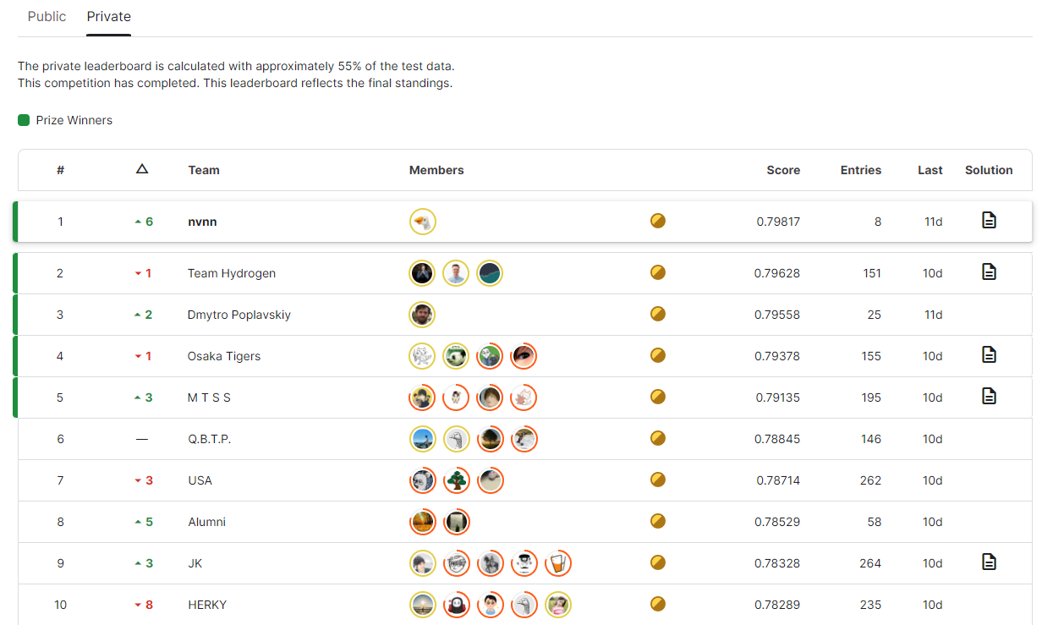
Background
Team Overview
Team Name: nvnn
Private Leaderboard Score: 0.798
Private Leaderboard Place: 1st
Team Member:
Nguyen Van Ngoc Nghia (nvnn)
Machine Learning Engineer - South Korea.
I am a machine learning engineer holding a master's degree in computer science.
I have taken part in numerous Kaggle competitions. Especially, I participated and won 2 solo gold medals in 1st and 2nd editions of the NFL competition. It definitely helped me succeed in this 3rd NFL competition.
‹#›

Slide 6
Summary

Slide 7
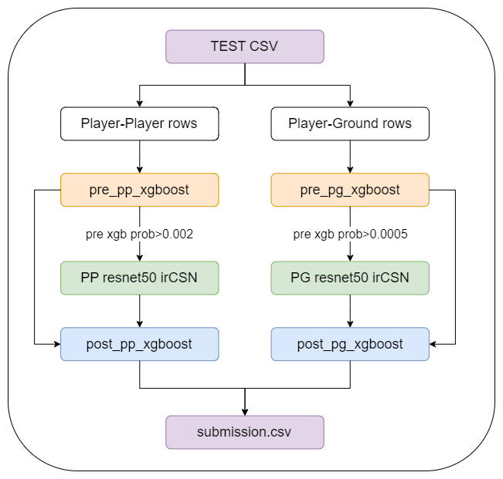
Summary
My approach comprises three main components
A xgb model to remove easy negative samples.
A CNN to classify potential contact
A xgb model to post-process the output

Slide 8
Pre processing XGBOOST

Slide 9
Features Selection/Engineering
Player-Player (PP) pre processing XGB
The most importance features
Distance between 2 players.
Helmet box coordinate of players.
the difference of tracking metadata of 2 players (s, a, dis, o, etc.).
in the same team?
This model helps to filter easy negative samples.
After filtering (threshold 0.005):
Filter ~70% samples (4.3 millions -> 1.4 millions)
recall rate of 99.3%

Slide 10
Features Selection/Engineering
Player-Ground (PG) pre processing XGB
The most importance features
Raw tracking metadata (a, sa, speed, o, dis, dir) from 50 neighbor steps
time step
This model helps to filter easy negative samples.
filtering (threshold 0.001):
Filter ~70% samples (410k -> 130k)
recall rate of 97+%

Slide 11
3D CNN Action Recognition

Slide 12
3D CNN Action Recognition
PP resnet50 irCSN model
The PP model is trained using input from three sources endzone, sideline video, and NGS tracking data:
18 neighboring frames are extracted and cropped around the helmet bboxes, {frame[-44], -37, -30, -24, -18, -13, -8, -4, -2, 0, 2, 4, 8, 13, 18, 24, 30, frame[37]}.
The head of 2 players are mask with black and white color.
The NGS tracking data is simulated as images and stack with cropped endzone and sideline.
resnet50-irCSN from mmaction2 are used to train these input.

Slide 13
3D CNN Action Recognition
PP resnet50 irCSN model
The PP model is trained using input from three sources endzone, sideline video, and tracking data:
Notes:
<a href="https://ibb.co/hL4ZbgX"><img src="https://i.ibb.co/k5w9jG3/output.gif" alt="output" border="0"></a><br /><a target='_blank' href='https://imgbb.com/'>picture url</a><br />

Slide 14
3D CNN Action Recognition
PG resnet50 irCSN model
The PG model is trained using input from two sources endzone and sideline video:
23 neighboring frames are extracted and cropped around the helmet bboxes.
The head of player are mask with white color.
resnet50-irCSN from mmaction2 are used to train these input.
Notes:
<a href="https://imgbb.com/"><img src="https://i.ibb.co/SwdKw2w/output-g.gif" alt="output-g" border="0"></a>

Slide 15
3D CNN Action Recognition
PG resnet50 irCSN model
config 11: use BGR images directly as input
Notes:
<a href="https://imgbb.com/"><img src="https://i.ibb.co/SwdKw2w/output-g.gif" alt="output-g" border="0"></a>

Slide 16
3D CNN Action Recognition
PG resnet50 irCSN model
config 15: use 3 continuous gray scale images as input.
23 neighboring frames are extracted and cropped around the helmet bboxes.
The head of player are mask with white color.
resnet50-irCSN from mmaction2 are used to train these input.
Notes:
<a href="https://imgbb.com/"><img src="https://i.ibb.co/4KL7ZHp/output-15-G.gif" alt="output-15-G" border="0"></a>

Slide 17
Training Methods

Slide 18
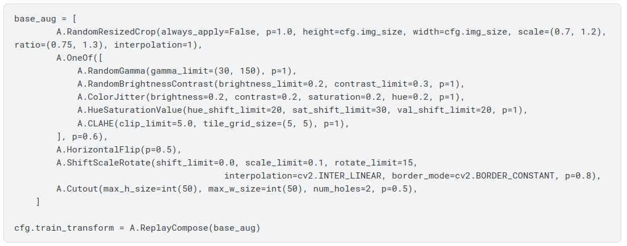
Training Methods
Endzone and sideline augmentation
The NGS tracking image augmentation: horizontal, vertical flips and shifting
Kaggle Winner Presentation Template

Slide 19
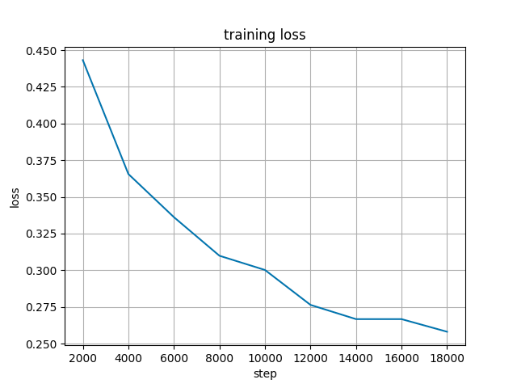
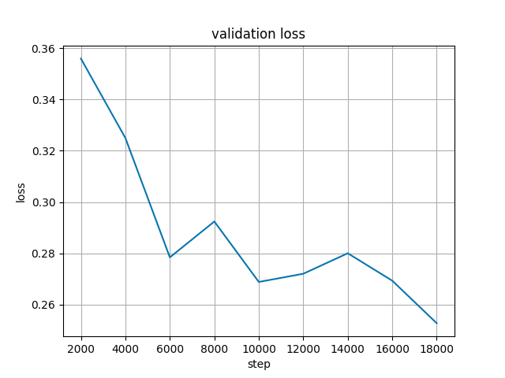
Training Methods
Training set up:
Learning rate: 4e-5
Learning rate scheduler: linear
Batch size: 6
Epoch: 1
Loss: BCEWithLogitLoss
PP model fold2 train-val loss
Kaggle Winner Presentation Template

Slide 20
Post processing XGBOOST

Slide 21
Features Selection/Engineering
Player-Player (PP) post processing XGB
Features: The ensemble probability of xgb pre-processing model and 3d CNN model (prob = 0.2*pre_xgb + 0.8*cnn) from 20 neighbor steps.
This model improves the CV score approximately 0.005.

Slide 22
Features Selection/Engineering
Player-Ground (PG) post processing XGB
Features:
The raw predicted probability of xgb pre-processing model from 20 neighbor steps.
The raw predicted probability of 3d CNN model from 20 neighbor steps.
The ensemble probability of xgb pre-processing model and 3d CNN model (prob = 0.15*pre_xgb + 0.85*cnn) from 30 neighbor steps.
This model boosts the CV score approximately 0.04.

Slide 23
Important and Interesting Findings

Slide 24
Important and Interesting Findings
Simulating NGS tracking position as images and stacking it with endzone and sideline data significantly improve the performance of PP model.
Using xgboost to post-process the prediction from the pre-processing step and CNN model also bring a decent boost, especially to the PG model.
An action recognition model seems to work better than normal 3D CNN or 2.5D CNN.
Kaggle Winner Presentation Template

Slide 25
Question and Answer

